Slide 1
Modeling with BIS
Modeling for a Digital Twin

Slide 2
BIS Modeling
Digital Twin: A virtual representation of reality designed to be leveraged by many different applications that may be unknown at design time.
“Silo” Repository: Application-specific repository with data-model optimized for specialized disciplines, workflows, lifecycle phases, etc.
BIS is for modeling a Digital Twin
Information is organized around a “physical backbone” and the systems in which physical objects participate
In a single repository, BIS cohesively handles:
Multiple Modeling Perspectives
Multiple Modeling Granularities
BIS does not preclude purpose-specific “materialized views” synchronized with the Digital Twin

Slide 3
Start with the real world…
Real World
Physical
Object

Slide 4
Break the Real-World Object into Entities (Each “Entity” is from a different Modeling Perspective)
The Physical Object
as-a-whole
The physical form and business meaning of the object
Physical
Entity
The object’s role in a some other system or an alternate understanding of the object
The object’s role in a functional system
Functional
Entity
Other
Entity

Slide 5
Break the Object into Entities (Each “Entity” is from a different Modeling Perspective)
The physical form of the object
Physical
Entity
The object’s role in a some other system
The object’s role in a functional system
Functional
Entity
Other
Entity

Slide 6
As many Entities as you need…
Physical
Entity
Functional
Entity
Other
Entity
The object’s role in the safety of a facility
A simplified analytical view of the object, for a specific analysis
Safety
Entity
Analytical
Entity

Slide 7
Elements model entities
BIS Repository
Real World
The “lead” Element
models
Physical
Entity
PhysicalElement
fulfilled by
models
FunctionalElement
Functional
Entity
Other
Entity

Slide 8
More concise visuals…
BIS Repository
Real World
models
P-1
1
fulfilled by
models
F-1

Slide 9
More concise visuals…
BIS Repository
Real World
1
fulfilled by
F-1
P-1

Slide 10
Models are collections of Elements
BIS Repository
Real World
FunctionalModel
PhysicalModel
fulfilled by
1
F-1
P-1
1
fulfilled by
2
F-2
P-2
3
fulfilled by
F-3
P-3

Slide 11
Models sub-model “larger” Elements
BIS Repository
Real World
0
The larger Object
as-a-whole
fulfilled by
Parts of a larger Object
F-0
P-0
0
sub-models
sub-models
1
fulfilled by
1
F-1
P-1
2
fulfilled by
2
F-2
P-2
3
fulfilled by
F-3
P-3

Slide 12
Modeling an Object at multiple granularities in one BIS Repository
BIS Repository
Real World
The larger Object
as-a-whole
models
P-0
0
Parts of a larger Object
collectively models
sub-models
models
P-1
1
models
P-2
2
models
P-3
3

Slide 13
Where does it stop?
BIS Repository
Real World
?
The larger Object
as-a-whole
models
0
P-0
Parts of a larger Object
collectively models
sub-models
models
P-1
1
models
P-2
2
models
P-3
3

Slide 14
BIS Repository
Real World
“Whole” Object
RepositoryModel
Subject
mentions real-world Object
Establishes the perspective-Entity
0
PhysicalPartition
sub-models
models
Top-Model
“Parts” of the “Whole” Object
P-0
collectively models
(at finer granularity)
sub-models
Model
models
1
P-1
models
P-2
2
models
P-3
3

Slide 15
Modeling Entity 0 from two different granularities
Modeling Entity 4 as identifiable parts in a single model
BIS Repository
Real World
BIS Repository
RepositoryModel
“Whole” Object
RepositoryModel
“Whole” Object
Subject
mentions real-world Object
4
Subject
Establishes the perspective-Entity
0
5
6
PhysicalPartition
PhysicalPartition
sub-models
models
sub-models
Top-Model
Top-Model
“Parts” of the “Whole” Object
P-0
collectively models
“Parts” of the “Whole” Object
P-4
(at finer granularity)
parent-child
sub-models
P-5
P-6
Model
models
1
P-1
models
P-2
2
models
P-3
3

Slide 16
The RepositoryModel is the Table-of-Contents of the BIS Repository
BIS Repository
Introduces
Functional
Perspective
RepositoryModel
Real World
0
Subject
textually references
FunctionalPartition
PhysicalPartition
0
Introduces
Physical
Perspective
fulfilled by
F-0
P-0
1
1
sub-models
sub-models
fulfilled by
2
F-1
P-1
2
fulfilled by
3
F-2
P-2
fulfilled by
F-3
P-3

Slide 17
The RepositoryModel is the Table-of-Contents of the BIS Repository
BIS Repository
Introduces
Functional
Perspective
RepositoryModel
Real World
0
Subject
textually references
FunctionalPartition
PhysicalPartition
0
Introduces
Physical
Perspective
fulfilled by
F-0
P-0
1
1
sub-models
sub-models
fulfilled by
2
F-1
P-1
2
fulfilled by
3
F-2
P-2
fulfilled by
F-3
P-3

Slide 18
ElementHasChildElement Relationships
BIS Repository
RepositoryModel
Real World
0
Subject
textually references
FunctionalPartition
PhysicalPartition
0
fulfilled by
F-0
P-0
1
1
sub-models
sub-models
child
fulfilled by
2
F-1
P-1
2
child
child
fulfilled by
3
F-2
P-2
fulfilled by
F-3
P-3

Slide 19
Multiple Granularities ad infinitum
BIS Repository
Real World
0
RepositoryModel
textually references
0
Subject
FunctionalPartition
PhysicalPartition
1
1
fulfilled by
F-0
P-0
child
2
sub-models
sub-models
2
fulfilled by
F-1
P-1
3
fulfilled by
F-2
P-2
fulfilled by
F-3
P-3
4
sub-models
sub-models
5
fulfilled by
F-4
P-4
fulfilled by
F-5
P-5

Slide 20
Not all real-world Objects are physical..
Maintenance
Access Zone
Document
Real World
Spatial Location
Object
Real World
Physical
Object
Real World
Information
Object
Property Boundary
Requirement
Physical
Entity
Information
Entity
SpatialLocation
Entity
Functional
Entity
Other
Entity
Functional
Entity
Other
Entity
Functional
Entity
Other
Entity

Slide 21
Identification of Entities and Elements
EIFS Identity
FederationGUID=abd523f7
ICS Entry
Code (Serial #) = D2003-23-92-a
BIS Repository
PhysicalElement
ElementID = 23
FedGUID = abd523f7
Code = D2003-23-92-a
Real World
Identifies the Element
models
Physical
Entity
Identifies the real-world Entity that the Element represents
Identifies the Entity
fulfilled by
FunctionalElement
ElementID = 24
FedGUID = 923deeab
Code = BA-003
Functional
Entity
Other
Entity
models
EIFS Identity
FederationGUID=923deeab
ICS Entry
Code (Tag #) = BA-003

Slide 22
Identification of Entities and Elements
EIFS Identity
FederationGUID=abd523f7
ICS Entry
Code (Serial #) = D2003-23-92-a
BIS Repository
PhysicalElement
ElementID = 23
FedGUID = abd523f7
Code = D2003-23-92-a
Real World
Identifies the Element
models
Physical
Entity
Identifies the real-world Entity that the Element represents
Identifies the Entity
fulfilled by
FunctionalElement
ElementID = 24
FedGUID = 923deeab
Code = BA-003
Functional
Entity
Other
Entity
models
Some Other Database
Record
ID = 2999
FedGUID = abd523f7
EIFS Identity
FederationGUID=923deeab
ICS Entry
Code (Tag #) = BA-003

Slide 23
Identifiers captured in the Element
ElementId
64 Bit Integer
Unique per iModel
Identifies the Element.
FederationGuid
For identification across systems
Identifies the real-world entity
Code
A human readable identifier
Identifies the real-world entity
See next slide…

Slide 24
Codes
Every Element has a “Code” (nullable)
The Code is a human-readable identifier.
It identifies a real-world entity
It encodes some business meaning, Tag No, Room Number, Serial No
Elements have three properties supporting the Code:
A CodeScope pointing to an Element that defines the scope within which the Code must be unique
A CodeSpec pointing to a CodeSpecification, which defines how the Code is encoded and decoded, i.e. how it is formatted from business data (including managed alphanumeric sequences)
A CodeValue containing the actual human-readable string identifier

Slide 25
BIS Modeling Summary
Elements model Entities (Perspectives on real-world Objects)
A set of related Elements model the “complete” Object
The “lead” Element depends on the nature of the Object
A Model is a collection of Elements
From a single Perspective
From a single Granularity
A BIS Repository is a cohesive set of Models
A RepositoryModel serves as Table-of-Contents
The Subject textually describes the overall subject of the iModel
Partitions establish Perspectives
A Model sub-models an Element, forming a hierarchy that keeps the relative Modeling Granularities clear

Slide 26
THE END

Slide 27


TypeScript
Classes
XML Schema
JSON
Schema
generate
generate
generate
Base Infrastructure Schemas
(All Relevant Domains)
Open-Source Development with Siemens
OData
EDMX Schema
Schema
generate
generate
generate
RDFS/OWL Ontology

Slide 28
Responsible Party A
Responsible Party B
Responsible Party C
Model 1
Model 2
Model 3

Slide 29
Identification of Entities and Elements
EIFS Identity
FederationGUID=abd523f7
ICS Entry
Code (Serial #) = D2003-23-92-a
BIS Repository
PhysicalElement
ElementID = 23
FedGUID = abd523f7
Code = D2003-23-92-a
Real World
Identifies the Element
models
Physical
Entity
Identifies the real-world Entity that the Element represents
Identifies the Entity
fulfilled by
FunctionalElement
ElementID = 23
FedGUID = abd523f7
Code = BA-003
Functional
Entity
Other
Entity
models
EIFS Identity
FederationGUID=923deeab
ICS Entry
Code (Tag #) = BA-003

Slide 30
Whole-Part in the physical world
Real World
Real World
0
0
0
0
1
1
1
1
3
3
2
2
4
7
4
7
6
5
6
5
8
Entity 8 cannot be part of both Entity 2 and Entity 3. Of course, a whole can be a part of some larger whole, so Entity 5 is part of Entity 3 and also part of Entity 0.

Slide 31
How to model a real-world Entity
How should a given real-world Entity be modeled?
Does it have parts?
no
Model it as an “atomic” Element
yes
Are they individually identified?
no
Model it an “atomic” Element with parts represented in GeometryStream of the Element
yes
Considered
both as a whole and also as individual parts?
yes
Model parts in a sub-Model
no
Use parent-child modeling

Slide 32
How to model a real-world Entity
How should a given real-world Entity be modeled?
Does it have parts?
no
Model it as an “atomic” Element
yes
Are they individually identified?
no
Model it an “atomic” Element with parts represented in GeometryStream of the Element
yes
Considered
both as a whole and also as individual parts?
yes
Are the parts “always” controlled
by a single party?
yes
Model parts in a sub-Model
no
no
Use parent-child modeling
Use “aggregates” relationship

Slide 33
3D Modeling Perspectives
Geometric3d
(cartesian)
Spatial
(geolocated)
Analytical
(simplified geometric abstraction)
GraphicalElement3d
(visual depiction of data)
Physical
(has mass)
StructuralAnalysis
(Simplified geometric model of structures)
SpatialLocation
(massless, makes sense in physical context)

Slide 34
3D Modeling Perspectives
Geometric3d
(cartesian,
spatially locatable)
Spatial
(always spatially located)
Analytical
(simplified geometric abstraction)
GraphicalElement3d
(visual depiction of data)
Legend:
Normal – Model is concrete
Italics – Model is abstract
Underline – Model is sealed
Physical
(has mass)
StructuralAnalysis
(Simplified geometric model of structures)
SpatialLocation
(massless, makes sense in physical context)

Slide 35
3D Modeling Perspectives
Geometric3d
(cartesian, geolocateable)
Spatial
(in real space)
Analytical
(simplified geometric abstraction)
GraphicalElement3d
(visual depiction of data)
ProjectedLocation
(in real space)
Physical
(has mass)
StructuralAnalysis
(Simplified geometric model of structures)
SpatialLocation
(massless, makes sense in physical context)

Slide 36
3D Modeling Perspectives
Geometric3d
(cartesian, geolocateable)
Spatial
(in real space)
ProjectedLocation
(projected to a plane)
Analytical
(simplified geometric abstraction)
GraphicalElement3d
(visual depiction of data)
Physical
(has mass)
StructuralAnalysis
(Simplified geometric model of structures)
SpatialLocation
(massless, makes sense in physical context)

Slide 37
Physical Hierarchy Stereotypes
0
Site
Site
System
General
Component
Facility
Facility
General
Component
System
System
Component
Facility
System
General
Component

Slide 38
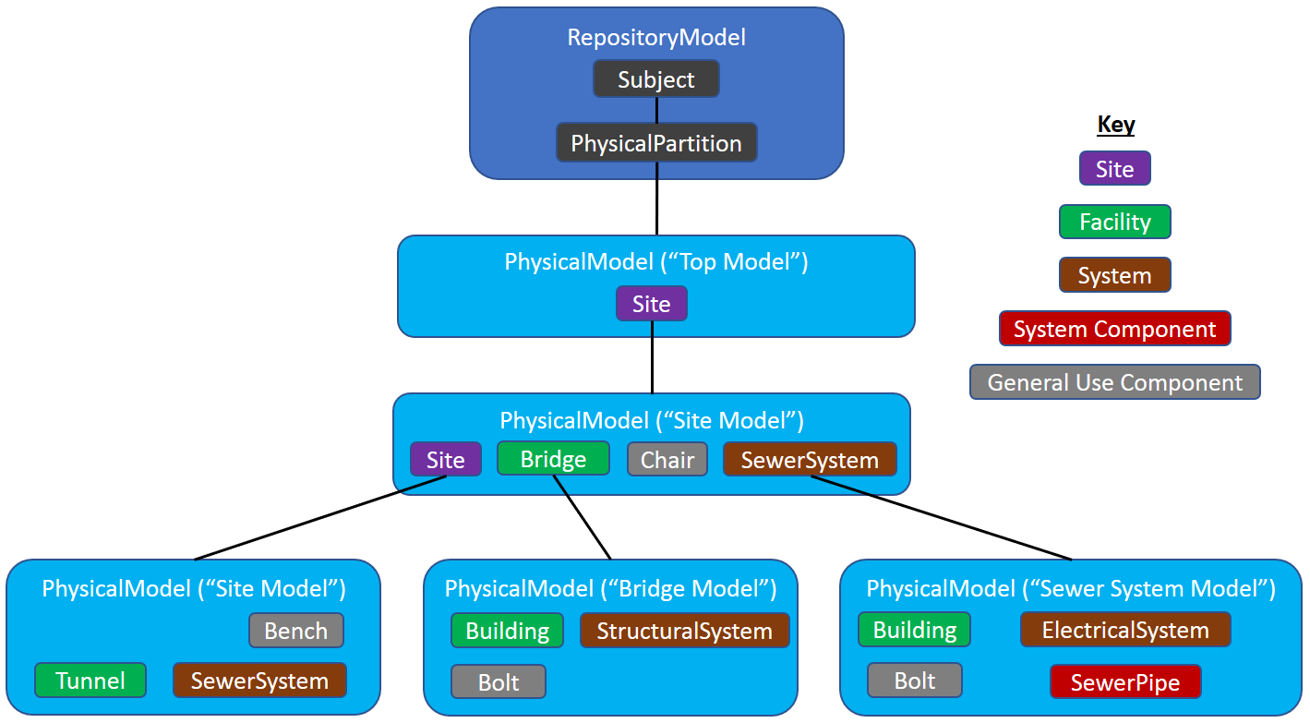

Slide 39
Physical Hierarchy Stereotypes
0
Site
Site
System
General
Component
Facility
Facility
General
Component
System
System
Component
Facility
System
General
Component

Slide 40
Physical Hierarchy Stereotypes
0
Site
Site
System
General
Component
Facility
Facility
General
Component
System
System
Component
Facility
System
General
Component

Slide 41
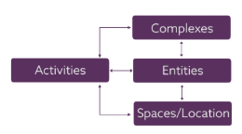
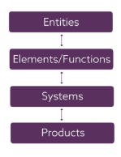
UNICLASS
https://toolkit.thenbs.com/articles/classification
Complex
Entity
Space
Element
System
Product

Slide 42
Physical Hierarchy Stereotypes
UNICLASS
BIS
0
Complex
Site
Site
System
General
Component
Entity
Facility
Space
Element
Facility
General
Component
System
System
System
Component
Facility
System
General
Component
Product

Slide 43
Physical Hierarchy Stereotypes
UNICLASS
BIS
0
Complex
Site
Site
System
General
Component
Entity
Facility
Space
Element
Facility
General
Component
Facility
Part
System
System
System
Facility
Part
System
Component
Facility
System
General
Component
General
Component
Product

Slide 44
Physical Hierarchy Stereotypes
UNICLASS
BIS (simplified)
0
Complex
Site
Entity
Facility
Space
Space
Element
Facility
Part
System
System
Product
System
Component
General
Component

Slide 45
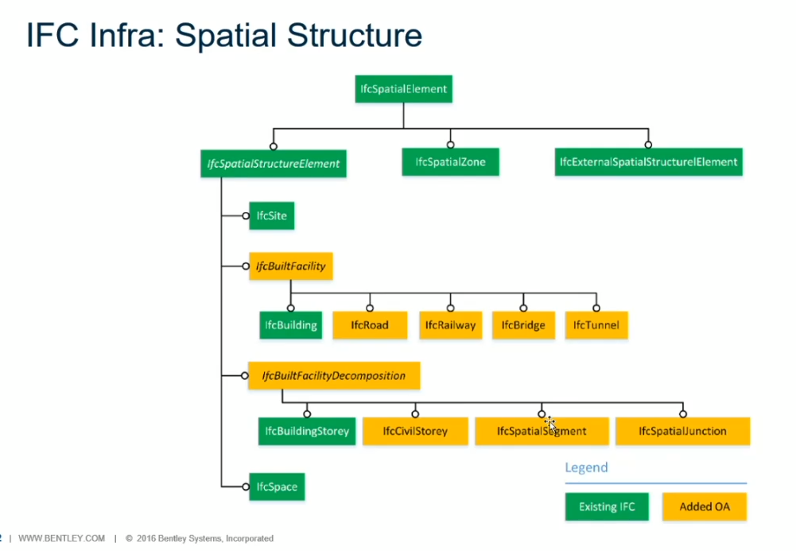
Diego on IFC road railhttps://web.microsoftstream.com/video/ef9a4fae-31fd-44d0-ad02-ec8a3acba14a

Slide 46
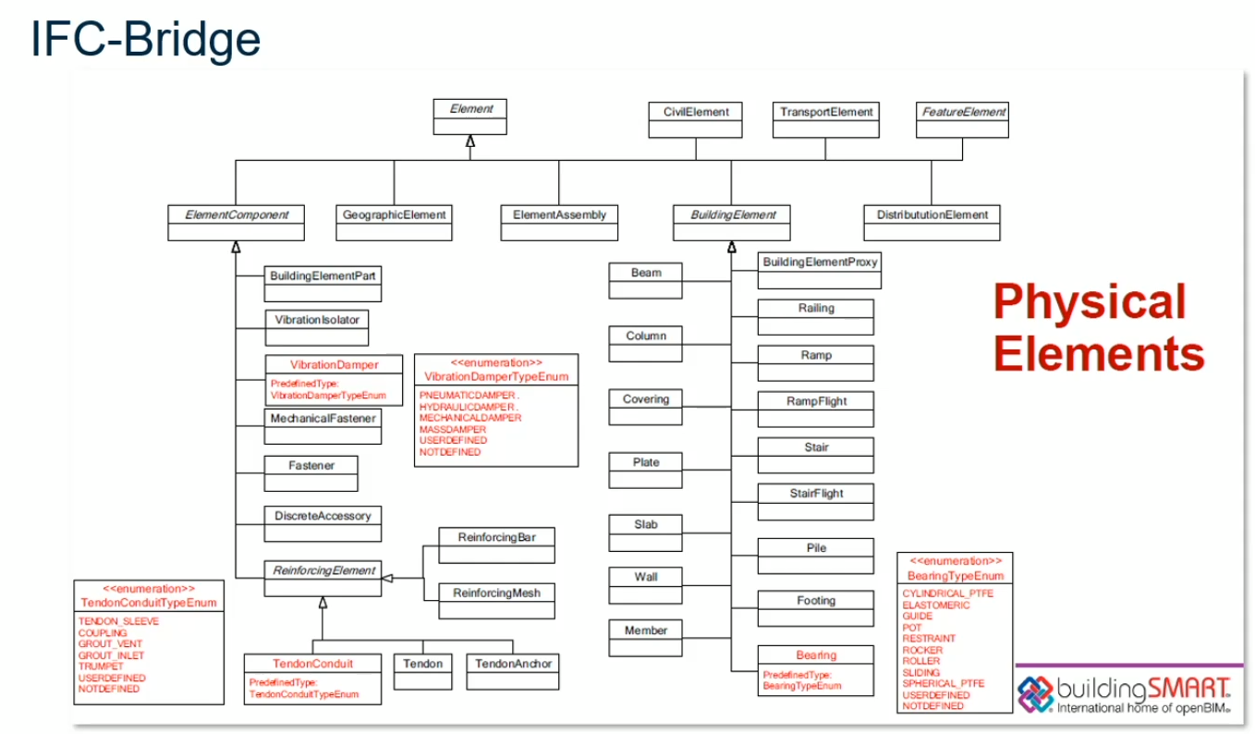

Slide 47
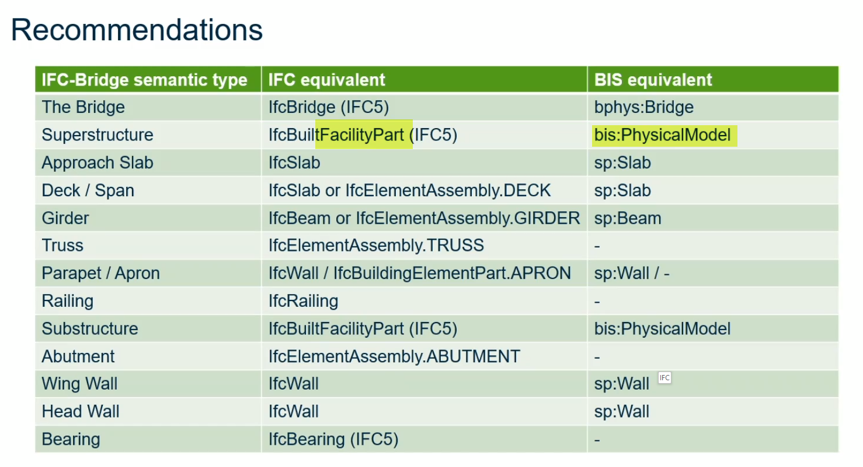

Slide 48
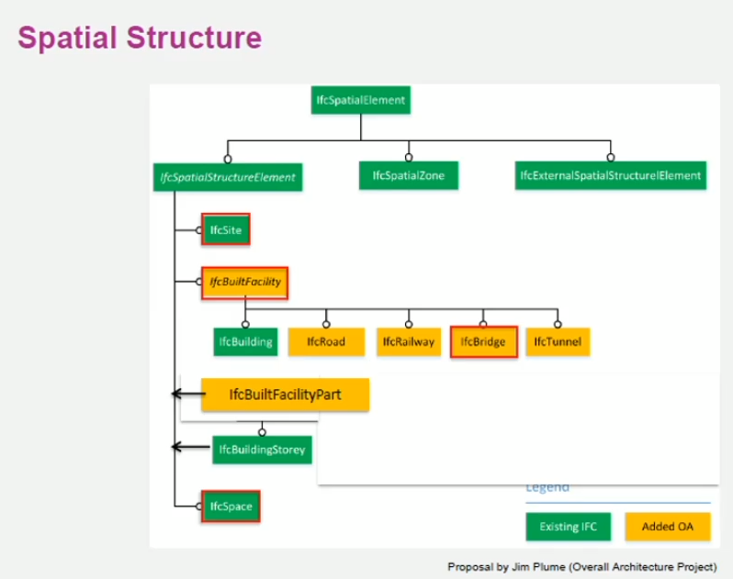
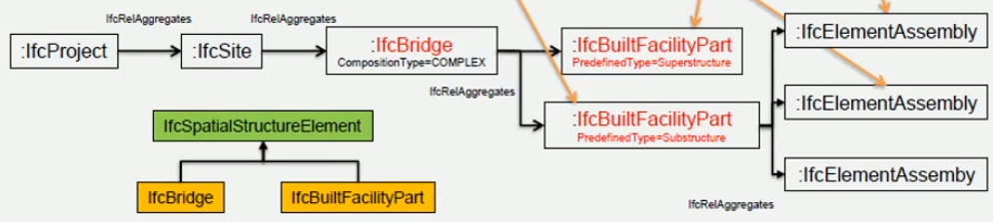
IFC
Meik Kabath on IFC https://web.microsoftstream.com/video/b9bc8e76-554e-4ed7-9a1c-ce87e5243ed4
Project
Site
Facility
FacilityPart
Assembly
Element
Space
Assembly
Element
Element

Slide 49
Spatial/Physical Hierarchy
IFC
BIS (simplified)
UNICLASS
Project
Subject
0
Complex
Site
Site
Space
Entity
Facility
Facility
Space
Space
FacilityPart
System
Facility
Part
Element
Assembly
Space?
System
Element
System
Space
Assembly
Assembly
Element
System
Component
General
Component
Product
Element
Notes:
Site, Facility, FacilityPart, Space are spatial containers… PhysicalElements go in them
UNICLASS CLASS is instance data. We can sugg
BIS for UNICLASS people…
BIS for OnmiClass people
BIS for IFC people

Slide 50
BIS Mereology
parent-child = independent, but “owned by”
sub-model = a finer-grained model of
parent-child
sub-models

Slide 51
UNICLASS
https://toolkit.thenbs.com/articles/classification

Slide 52
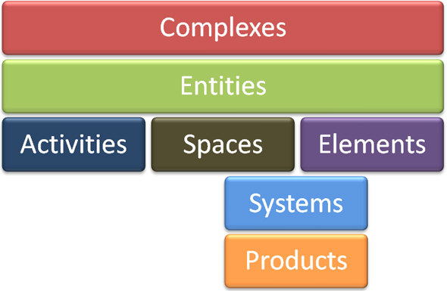
UNICLASS
https://toolkit.thenbs.com/articles/classification

Slide 53
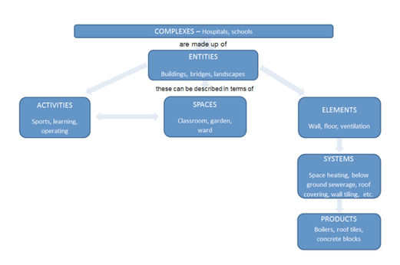
UNICLASS
https://toolkit.thenbs.com/articles/classification

Slide 54
UNICLASS
https://toolkit.thenbs.com/articles/classification
UNICLASS
Complex
Entity
Space
Element
System
Product

Slide 55
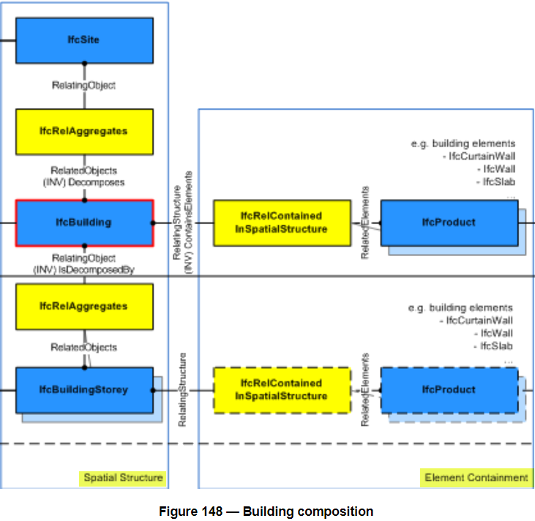
IFC Spatial/Physical

Slide 56

Spatial/Physical Hierarchy: IFC
Spatial Structure Hierarchy
UNICLASS
Project
Complex
Site
Space
Element Containment
Entity
Facility
Space
Space
Product
Assembly
Element
FacilityPart
Product
System
Space
Product
SpatialStructureElement
contains
Element
CompositionType
groups
Should we sub-class where they use CompositionType enum?
services
System
Notes:
https://standards.buildingsmart.org/IFC/RELEASE/IFC4_1/FINAL/HTML/schema/ifcproductextension/lexical/ifcbuilding.htm
Site, Facility, FacilityPart, Space are spatial containers… PhysicalElements go in them
UNICLASS CLASS is instance data. We can sugg
BIS for UNICLASS people…
BIS for OnmiClass people
BIS for IFC people

Slide 57
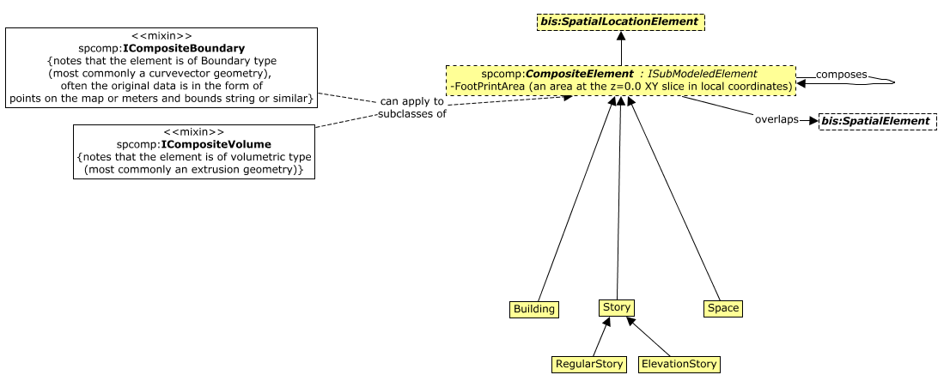

Slide 58
BIS Mereology
parent-child = independent, but “owned by”
sub-model = a finer-grained model of
portion-of = A portion of element,
explicitly modeled in a sub-model
parent-child
portion-of
sub-models

Slide 59
Spatial/Physical Hierarchy: BIS Current
Spatial Structure Hierarchy
UNICLASS
Subject
0
Complex
Entity
Building
Space
Regular
Story
Element
Story
has subclasses
Elevation
Story
System
Space
Product
Assembly
CompositeElement
overlaps
Physical
Element
can be
Product
Notes:
Site, Facility, FacilityPart, Space are spatial containers… PhysicalElements go in them
UNICLASS CLASS is instance data. We can sugg
BIS for UNICLASS people…
BIS for OnmiClass people
BIS for IFC people

Slide 60
Spatial/Physical Hierarchy: BIS
Spatial Structure Hierarchy
UNICLASS
Subject
0
Complex
Site
Entity
Building
IFC CompositionType
Space
Regular
Story
Element
Story
has subclasses
Elevation
Story
System
Should we sub-class where IFC use CompositionType enum?
Jonas: (infer from composes relationships.)
Glen: with one parent-child, is it complex-element or element-section?
Space
Product
Assembly
CompositeElement
overlaps
Physical
Element
can be
System
Product
System
Component
General
Component
Product
Notes:
Site, Facility, FacilityPart, Space are spatial containers… PhysicalElements go in them
UNICLASS CLASS is instance data. We can sugg
BIS for UNICLASS people…
BIS for OnmiClass people
BIS for IFC people

Slide 61
Spatial/Physical Hierarchy: BIS
Spatial Structure Hierarchy
Spatial Structure Hierarchy
Project
Subject
0
Site
Site
Space
Facility
Facility
IFC CompositionType
Space
Regular
Story
FacilityPart
FacilityPart
has subclasses
Space
Elevation
Story
Should we sub-class where IFC use CompositionType enum?
Jonas: (infer from composes relationships.)
Glen: with one parent-child, is it complex-element or element-section?
Space
Assembly
CompositeElement
overlaps
Physical
Element
can be
System
Product
System
Component
General
Component
Product
Notes:
Site, Facility, FacilityPart, Space are spatial containers… PhysicalElements go in them
UNICLASS CLASS is instance data. We can sugg
BIS for UNICLASS people…
BIS for OnmiClass people
BIS for IFC people

Slide 62
Spatial/Physical Hierarchy
Siemens BT
IFC
BIS (simplified)
Project
Subject
0
Site
Site
Site
Outside
Space
Campus/CampusSegment/
Facility
Facility
Space
Building/BuildingSegment
FacilityPart
System
Facility
Part
Floor
Assembly
Space?
Element
System
Space/Room
Space
Assembly
Assembly
Element
System
Component
General
Component
Asset
Element
Product
Notes:
Site, Facility, FacilityPart, Space are spatial containers… PhysicalElements go in them
UNICLASS CLASS is instance data. We can sugg
BIS for UNICLASS people…
BIS for OnmiClass people
BIS for IFC people

Slide 63
Physical Hierarchy Stereotypes
IFC
BIS (simplified)
UNICLASS
Project
Subject
0
Complex
Site
Site
Space
Entity
Facility
Facility
Space
Space
FacilityPart
Facility
Part
Element
Assembly
Space?
System
Element
System
Space
Assembly
Assembly
Element
System
Component
General
Component
Product
Element
Notes:
Site, Facility, FacilityPart, Space are spatial containers… PhysicalElements go in them
UNICLASS CLASS is instance data. We can sugg
BIS for UNICLASS people…
BIS for OnmiClass people
BIS for IFC people

Slide 64
Where else can Space go in Uniclass?

Slide 65
Example - Spatial Modeling (Web view)
This page provides a preliminary, example strategy for how:
IFC
CityGML
CCOM
Could influence and be mapped to a BIS Spatial organization.
Standards
IFC
IFC has a reasonably complete set of spatial classes
IfcSpatialElement
IfcExternalSpatialStructureElement - for extension
IfcExternalSpatialElement - ….
IfcSpatialStructureElement - for hierarchical spaces
IfcBuilding
IfcBuildingStorey
IfcSite
IfcSpace
IfcSpatialZone - non hierarchical space
IfcZone - a group of IfcSpace
For the IfcSpatialStructureElement, there is also the concept of tagging "complex" vs "element" vs "partial" to allow sub-sites, aggregate sites, etc.
CityGML
CityGML has:
a LandUse concept that appears to be for non-overlapping earth surface areas.
A Room concept
A HollowSpace concept (primarily for tunnels)
A BridgeRoom concept (for bridges)
However, CityGML uses the last 3 concepts (Room, HollowSpace, BridgeRoom) as part of the physical breakdown, so perhaps they can be neglected for Spatial Modeling.
.
CCOM
CCOM has a Site class, but this is for a different concept. It is effectively a facility. (it also mixes the functional and physical together in a single concept)
Driving Standard and Design
Upon quick inspection, it appears:
IFC should be the Driving Standard.
Some expansion or mapping should be done to include the LandUse concept

Slide 66
How to model a real-world Entity
How should a given real-world Entity be represented?
Does it have parts?
no
Make it an “atomic” Element
yes
Are they individually identified?
no
Make it an “atomic” Element and represent parts in GeometryStream of an Element
yes
Are whole & parts modeled by the same person?
no
Represent parts in a sub-Model
yes
OK to represent parts as child Elements, but breaking down in a sub-Model is also an option

Slide 67
How to model a real-world Entity
How should a given real-world Entity be modeled?
Does it have parts?
no
Model it as an “atomic” Element
yes
Are they individually identified?
no
Model it an “atomic” Element with parts represented in GeometryStream of the Element
yes
Are whole & parts modeled by the different people?
yes
Model parts in a sub-Model
no
Model both as a whole and as a set of parts?
yes
Model parts in a sub-Model
no
Model parts as child Elements

Slide 68
Early in the lifecycle
BIS Repository
TemperatureInstrument
ElementID = 23
FedGUID = abd523f7
Code = TI-003
A = 12.1
B = 97
Real World
Temperature
Instrument
of type
TemperatureInstrumentType
Code = TI-Generic
DisplayLabel = Generic Temperature Instrument

Slide 69
Solution 1: Same Class, Different Type
BIS Repository
Real World
TemperatureInstrument
ElementId = 23
FedGUID = abd523f7
Code = TI-003
A = 12.1
B = 97
Temperature
Element
with H Alarm
of type
TemperatureInstrumentType
Code = TE-H-47
DisplayLabel = Temperature Element with H Alarm

Slide 70
Solution 2: More-Specialized Class, Different Type
BIS Repository
Real World
We should be able to keep ElementID the same…
TemperatureElement
ElementID = 23
FedGUID = abd523f7
Code = TI-003
A = 12.1
B = 97
Alarm = H
Should Code have changed?
A: It is a business decision.
Temperature
Element
with H Alarm
of type
TemperatureElementType
Code = TE-H-47
DisplayLabel = Temperature Element with H Alarm

Slide 71
Modeling Concepts
Elements model Entities
Elements can have child Elements (to model in greater detail)
A Model is a collection of Elements (sharing common Perspective)
What is the Model modeling? A: Something bigger
Where does it stop? A: At the RepositoryModel
It goes down, too… Breakdown Models

